Slide 1
Re-evaluating Circuit Mechanisms Underlying Pattern Separation
Presented by Liyuan

Slide 2
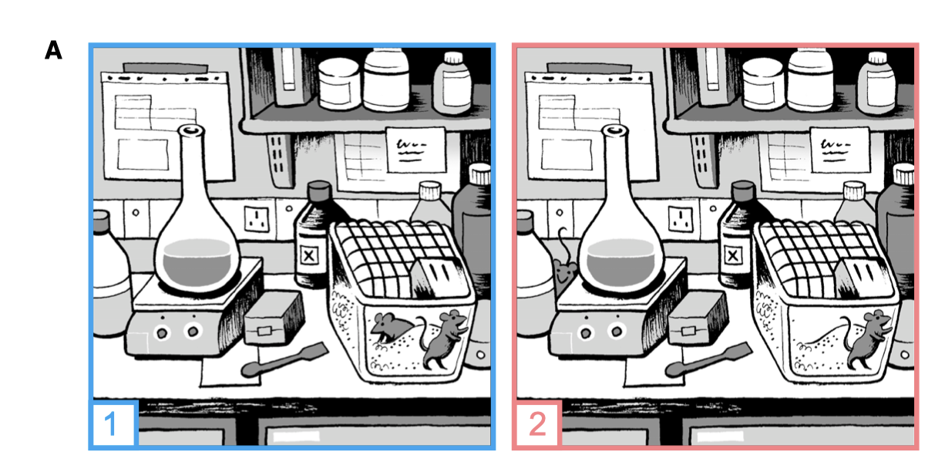
Why pattern separation
Sensory, proprioceptive, and motor information is represented by the spatiotemporal ﬁring patterns of populations of neurons.
Need to distinguish different patterns
Spot the difference

Slide 3
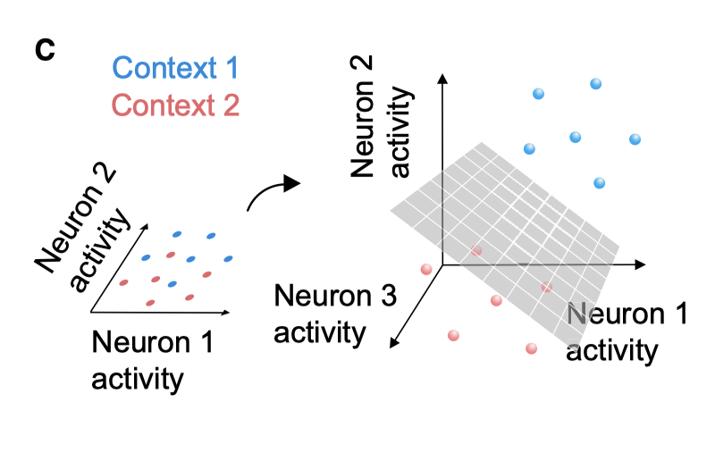

Pattern separation
a process in which neural circuits transform similar input activity patterns into more distinct output patterns.
Not needed in machine learning?

Slide 4
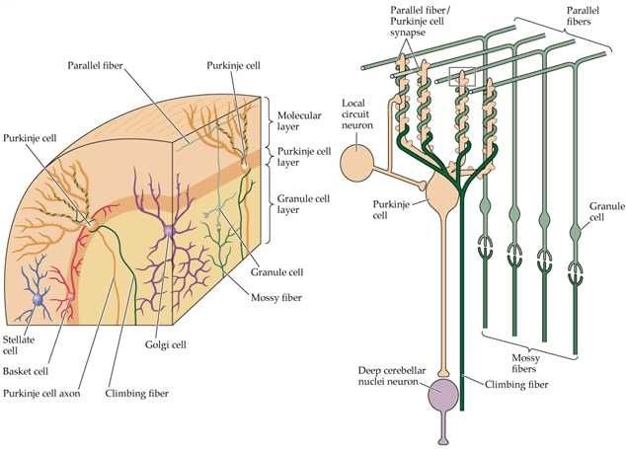
Cerebellar circuitry
200M mossy fibers
40,000M granule cells
15M Purkinje cells
1000 purkinje cells to 50 deep cerebellar nuclei in one functional section

Slide 5
Marr (1969): granule cell layer implements pattern separation
Large number of granule cells
Each granule cell receives inputs from few (<6) mossy fiber inputs
Theory: granule cell layer implements pattern separation by recoding mossy fiber inputs into higher dimension

Slide 6






Slide 7
Sparse coding
expansion recoding doesn’t necessarily imply population sparsity
Pattern separation = ultra sparse population coding
5-10% activation in mushroom body (insect olfactory system)
5% activation? In dentate gyrus

Slide 8
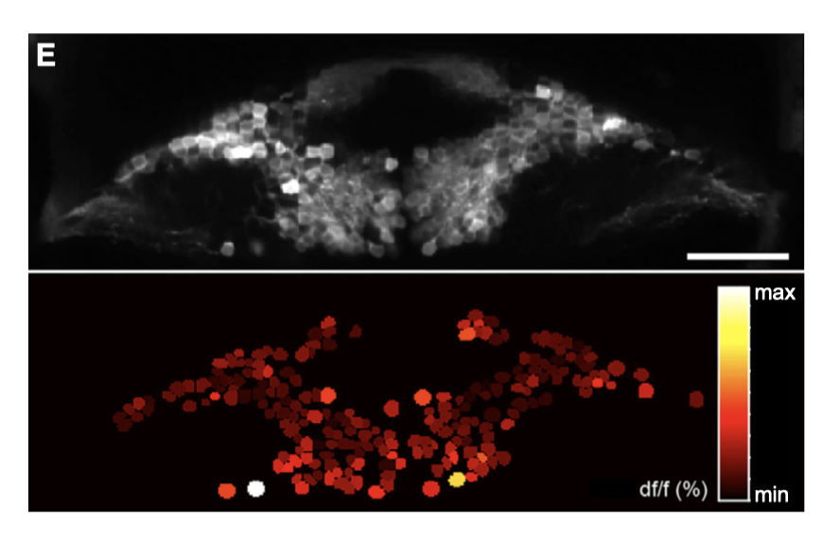
Sparse coding
Marr predicted that <5% of granule cells are active at any one time
Using calcium imaging to do large scale recording, up to 2/3 granule cells are active concurrently in cerebellum
Problems with calcium imaging
Different strategies for different areas
Trade-off between sparseness and information encoding
cerebellar granule cell somata of the larval zebraﬁsh

Slide 9
Decorrelation
Why
Imagine your mossy fiber input, copied to the granule cells. Remaining granule cells are fully correlated with one of these granule cells.
Subspace in higher dimension that is no different from input
Sparse synaptic connectivity
Thresholding or broad feedback inhibition

Slide 10
Dimensionality: A unifying framework
Expansive recoding – increases dimensions
Correlation – decreases dimensions
Difficult to determine in practice
Subsampling of neuronal populations
Limited range of tasks/stimuli

Slide 11
Conclusion
Pattern separation occurs in several areas in the brain, including cerebellum, dentate gyrus and insect mushroom body
Different circuits may implement different strategies to perform pattern separation

